Slide 1

Python/ Deep Learning Final Project Presentation Serverless Deep Learning
By Srinivas Rahul Sapireddy
UMKC ID: 16199986

Slide 2
Serverless
Serverless is the concept of removing infrastructure considerations for deploying code. Instead of having to manage servers and infrastructure by ourselves, a serverless service takes care of that for us and only charges according to use.
Here we have used AWS Lambda for deploying the model. Lambda is a service from AWS which allows us to deploy many different machine learning models.
Here we send the picture with the URL to the model that we are going to deploy with AWS Lambda and then the service will reply with different classes in which one this class will be pants and we will also have some score for it.
Here we use tensorflow-lite internally.

Slide 3
Problem Statement
Solving cloths classification problem using Serverless Deep Learning. Here we send the picture with the URL to the model that we are going to deploy with AWS Lambda and then the service will reply with different classes in which one this class will be pants and we will also have some score for it.

Slide 4
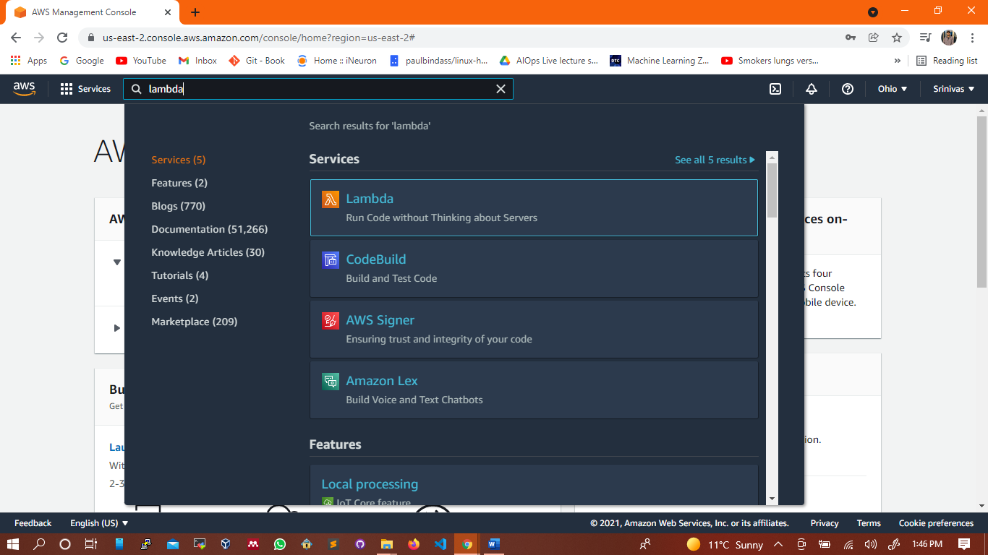
AWS Lambda

Slide 5
Description
Here I have introduced a clothes classification service. Where the user takes the picture of the clothes they want to wear. Then the classifier tells the user the classified classification. Here we use keras and tensorflow for image classification for classifying the pictures of different clothes and AWS Lambda for deploying the model.
Lambda
Lambda is a service from AWS which allows us to deploy many different machine learning models.
Here we send the picture with the URL to the model that we are going to deploy with AWS Lambda and then the service will reply with different classes in which one this class will be pants and we will also have some score for it. Here we use tensorflow-lite internally.

Slide 6
Questions Answered
What AWS Lambda is and difference between other approaches?
What is the tensorflow-lite and why it is better for this particular use case?
To this we will package everything in to a docker container and deploy it to AWS Lambda. Finally, we will expose this Lambda function as web service API gateway. Serverless is the concept of removing infrastructure considerations for deploying code. Instead of having to manage servers and infrastructure by ourselves, a serverless service takes care of that for us and only charges according to use.

Slide 7
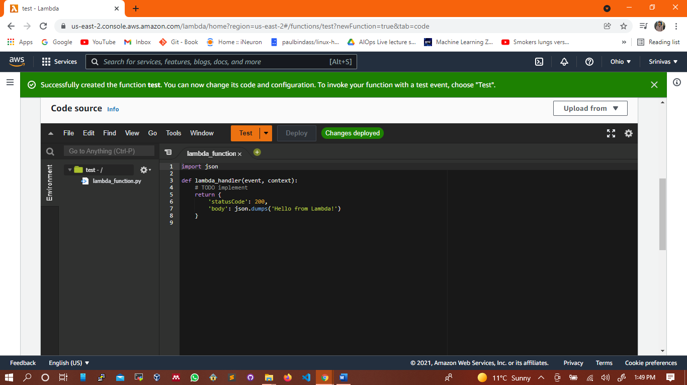
Writing lambda function

Slide 8
Parameters in the Lambda function
[1] Event – whatever we want to pass to the lambda function we pass it here.
[2] context – None

Slide 9
Advantages of using lambda service
There is no need to create any EC2 instances and no need to think about any servers. Here we just need to write a function and just user it.
No need to think about the infrastructure for serving the URL for serving the models. Here we pay only when lambda function is responding and don’t pay when it is idol and not in use. Here it is serverless and we don’t need to worry about servers.

Slide 10
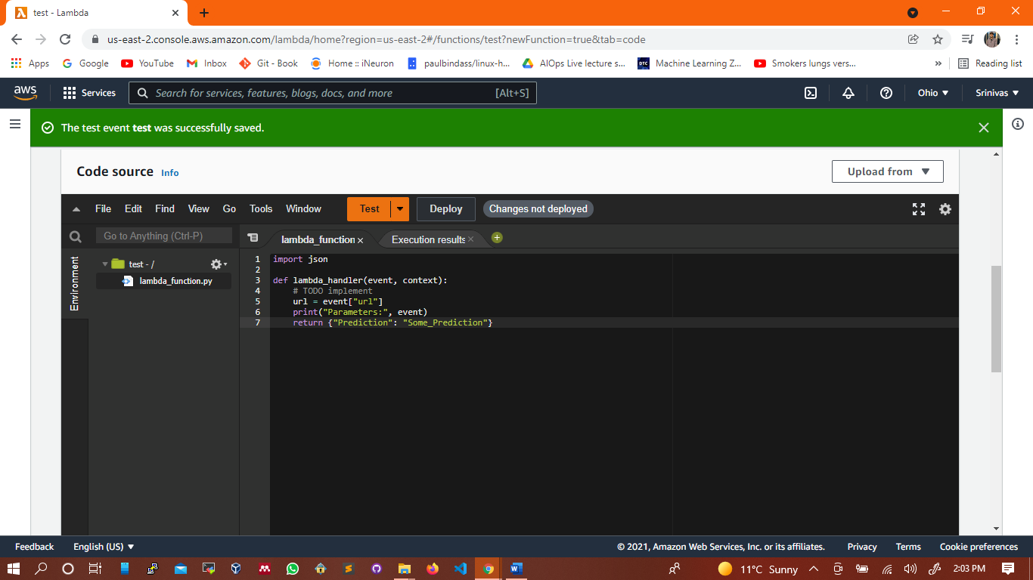
Testing lambda function

Slide 11
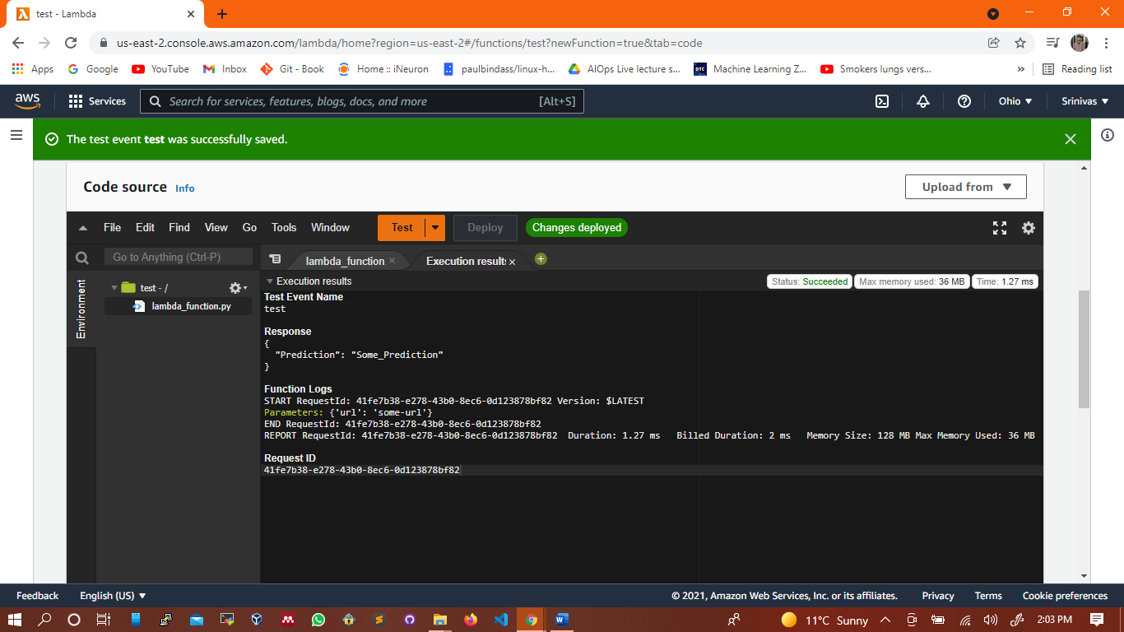
Output of test case

Slide 12
Tensorflow Lite
AWS Lambda has limit of the file size if can serve. That is less than 50MB zip file.
At present we have docker and have a larger limit. Up to 10GB. But if we have a larger image size it will be difficult to store the image. After invoking the Lambda function it will take some time to initialize. Also initializing the tensorflow also takes lot of time. And it also takes more RAM in it.
Here we use a lighter version of tensorflow which is tensorflow-lite. This will only focus on inference. It is not useful for training the models but only used for inferencing the models.

Slide 13
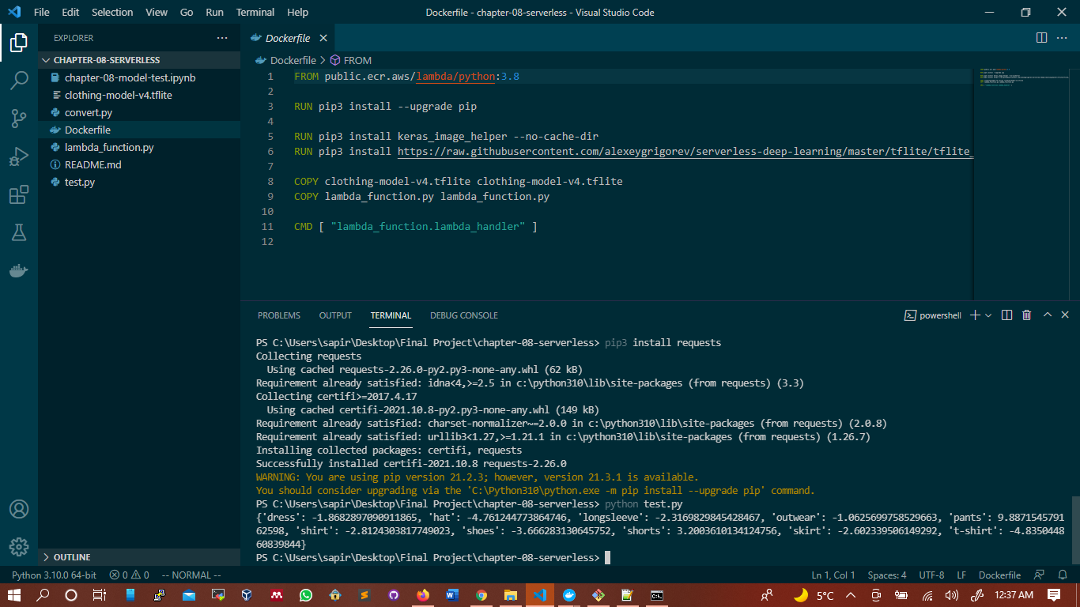
Preparing docker image for testing

Slide 14
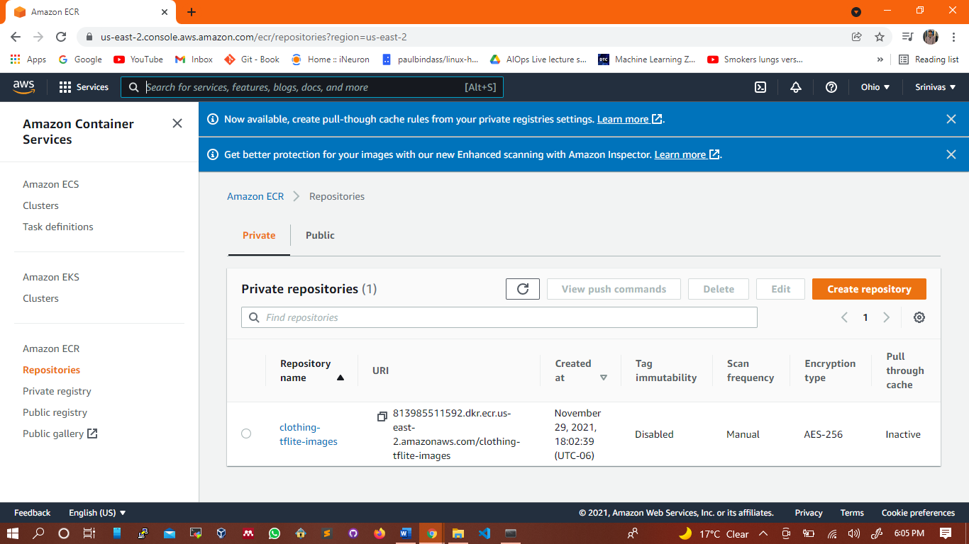
Deploying docker image to lambda function
Here we need to deploy the docker image to lambda. We publish the docker images in AWS ECR. ECR is where we publish the docker images.

Slide 15
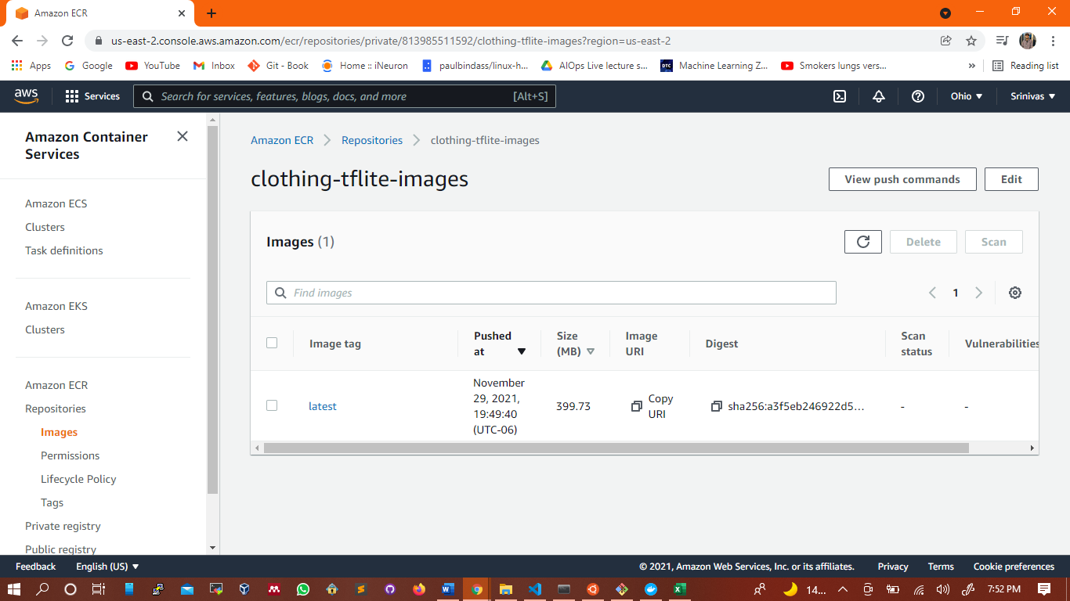

Slide 16
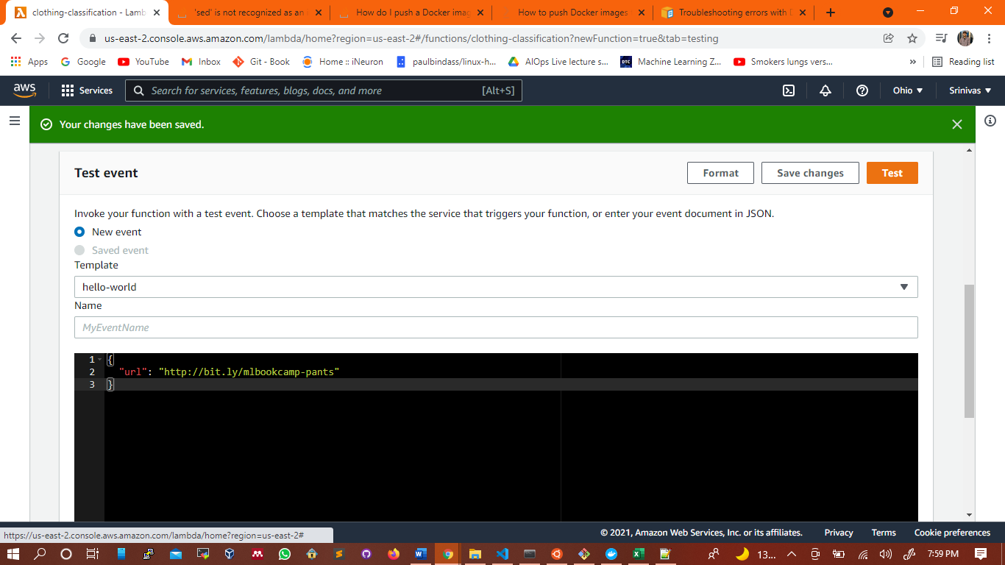
Testing the serverless ECR container docker image

Slide 17
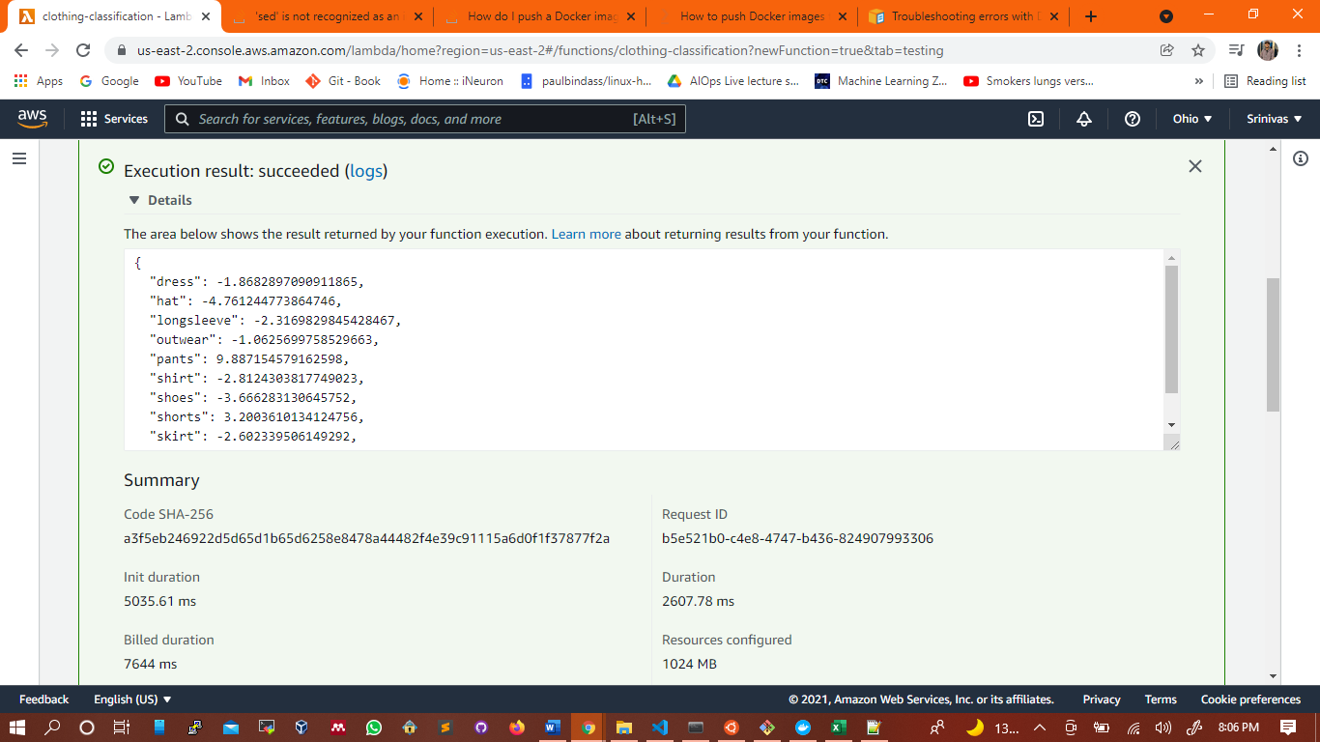
Results

Slide 18
Future Work
Understanding different methods of deploying and serving models in the cloud.
1
Serving Keras and TensorFlow models with TensorFlow-Serving
2
Deploying TensorFlow-Serving to Kubernetes
3

